Slide 1

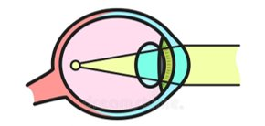
MYOPIA!

Slide 2
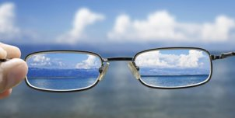
Background
Characteristics: Difficult seeing distant objects
Cause: Elongation of the eyeball, causing images to focus in front of the retina
Age of Onset: Typically between 8-12 years
Influencing Factors: Genetic predisposition and lifestyle factors
Dataset Source: Subset from the Orinda Longitudinal Study of Myopia
  -Evolved into the Collective Longitudinal Evaluation of Ethnicity and Refractive Error Study

Slide 3

Objective of the Study
Primary Objective: Identify and analyze factors contributing to the onset of Myopia in children
Sample Size: 618 subjects, non-myopic at entry, with a minimum of 5 years follow-up
Key Focus Areas: Ocular anatomy, Family History, Lifestyle choices (visual)
Methodology: Statistical analysis to establish correlations over a 5 year period
Goal: Provide insights into Myopia risk factors for future prevention and treatment strategies.

Slide 4


Variables: ID and STUDYYEAR
ID
-The ID variable is the subject identifier
STUDYYEAR
-The STUDYYEAR variable describes the year the subject entered the study

Slide 5


Variable: MYOPIC
The MYOPIC variable shows whether an individual, within the first 5 years of study, develops myopia.
Myopia is defined as a SPHEQ (Spherical equivalent refraction) less than or equal to (–0.75D) .
0=No the individual is not Myopic
1=Yes the individual is Myopic

Slide 6
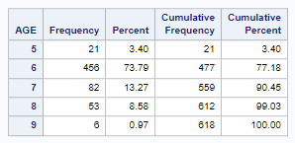
Variable: AGE
The AGE variable describes the age of the subject in years at the time of their first visit.

Slide 7


Variable: GENDER
Describes the Gender of the subject.
0=Male
1=Female

Slide 8
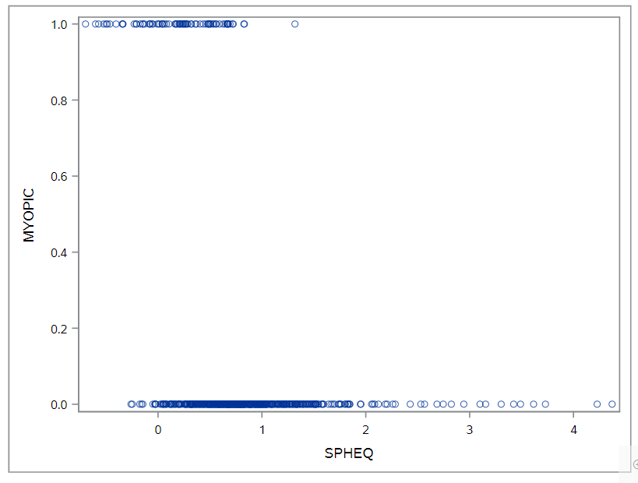
Variable: SPHEQ
The SPHEQ variable describes the spherical equivalent refraction.
The spherical equivalent refraction is a measure of the eye's effective focusing power. Eyes that are considered "normal"(no glasses required) have spherical equivalents between –0.25 diopter(D) and +1.00 D.
The more negative a spherical equivalent is, the more myopic the subject is.

Slide 9
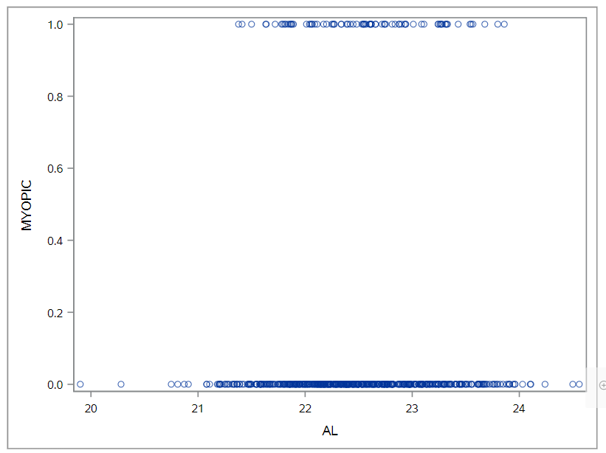
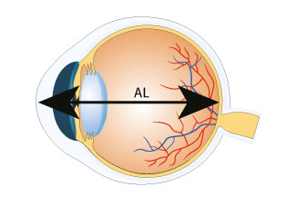
Variable: AL
The AL variable describes the Axial Length, which is the length of the eye from front to back
measured in mm.

Slide 10
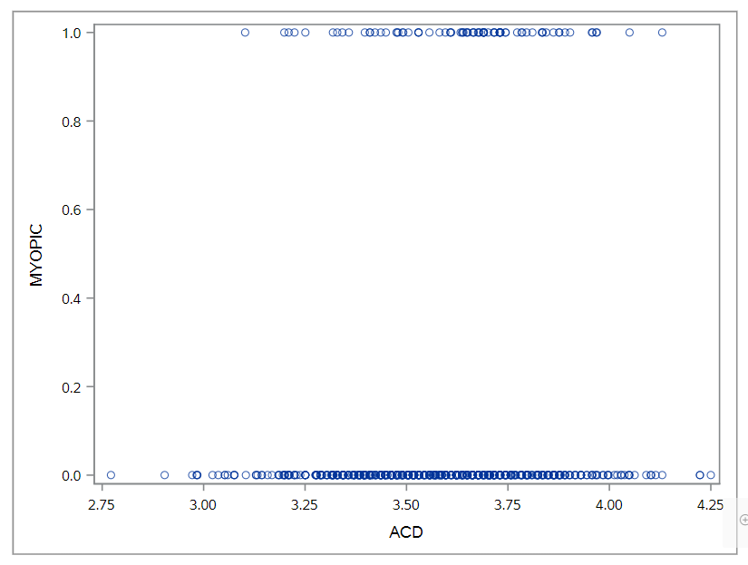
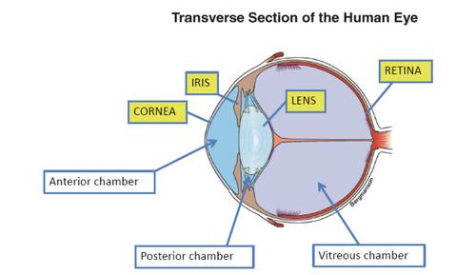

Variable: ACD
The ACD variable describes the Anterior chamber depth which is the length from front to back of the aqueous-containing space of the eye between the cornea and the iris

Slide 11
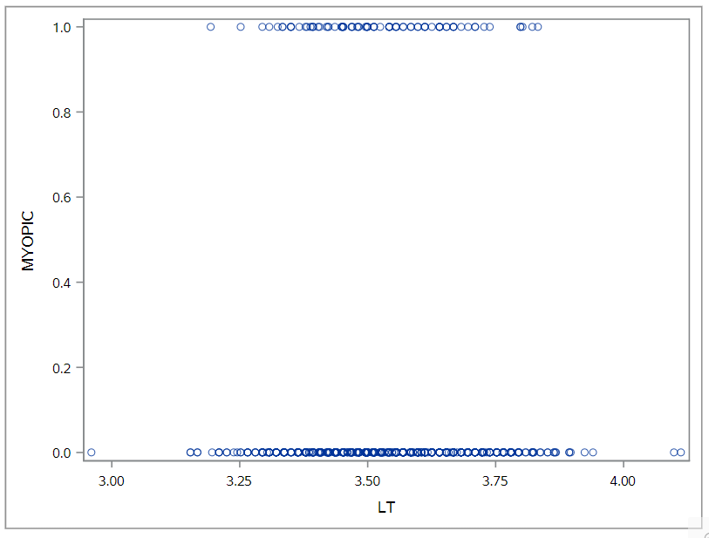
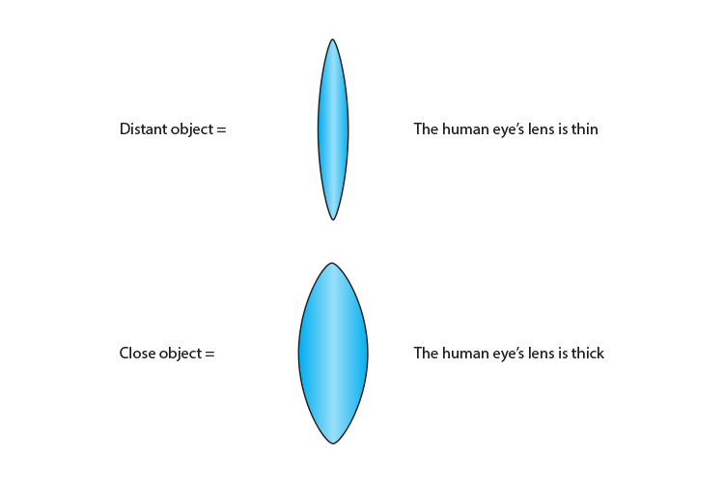
Variable: LT
The LT variable is the lens thickness.
The length from front to back of the crystalline lens.

Slide 12
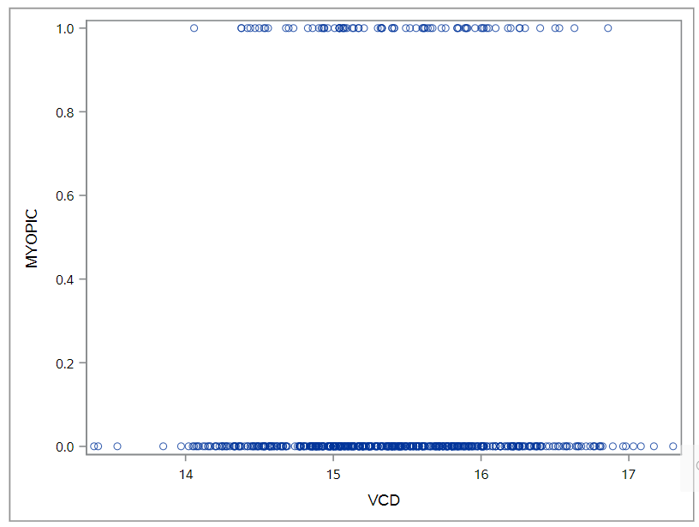
Variable: VCD
The VCD variable, which is the vitreous chamber depth, is the length from front to back of the aqueous-containing space of the eye in front of the retina.

Slide 13
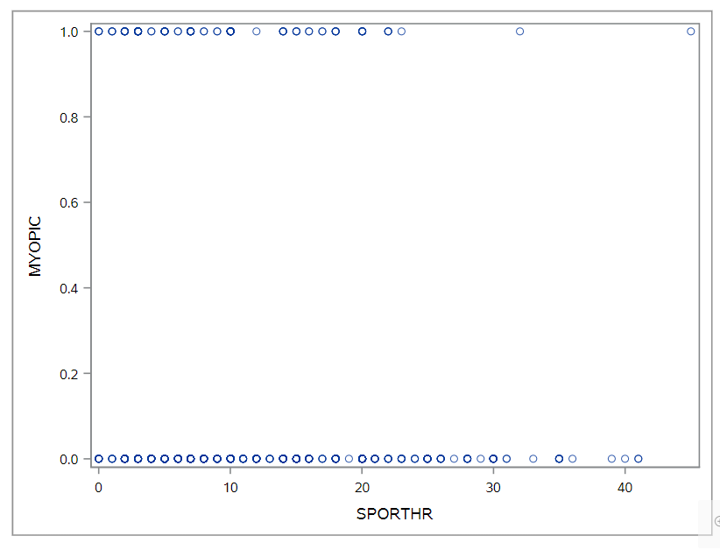

Variable: SPORTHR
The SPORTHR variable describes how many hours per week outside of school the child spent engaging in sports/outdoor activities

Slide 14
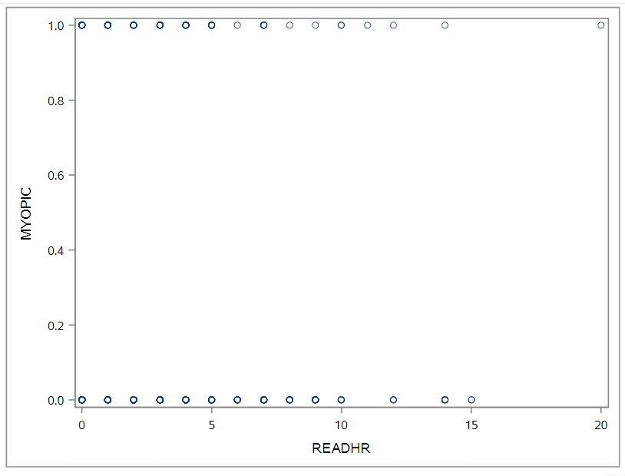

Variable: READHR
The READHR variable represents how many hours per week outside of the school the child spent reading for pleasure

Slide 15
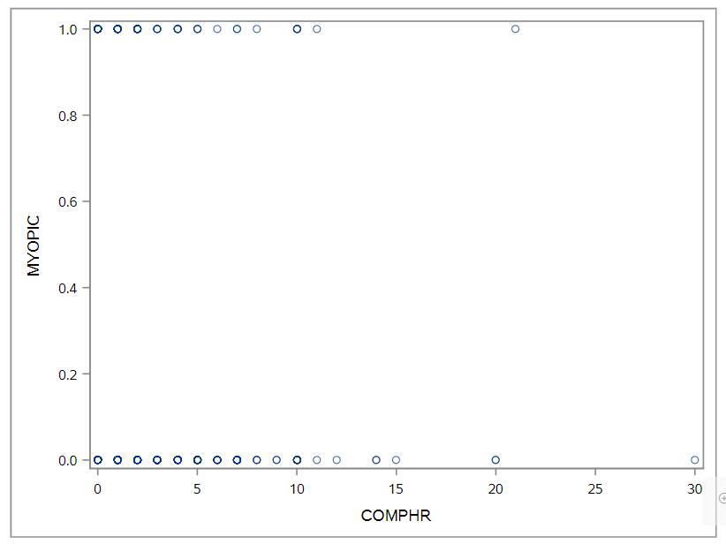

Variable: COMPHR
The COMPHR variable shows how many hours per week outside of school the child spent playing video/computer games or working on the computer

Slide 16
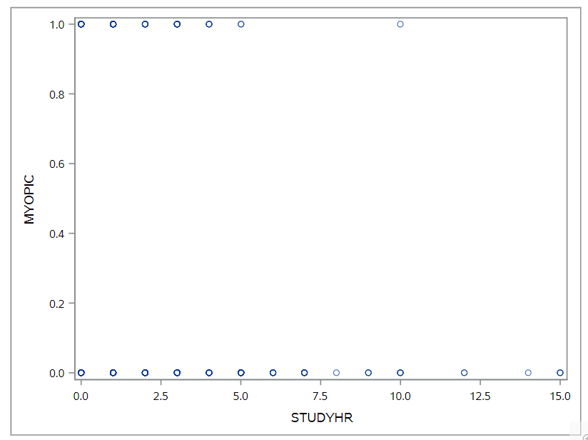

Variable: STUDYHR
The STUDYHR variable represents how many hours per week outside of school the child spent reading or studying for school assignments

Slide 17
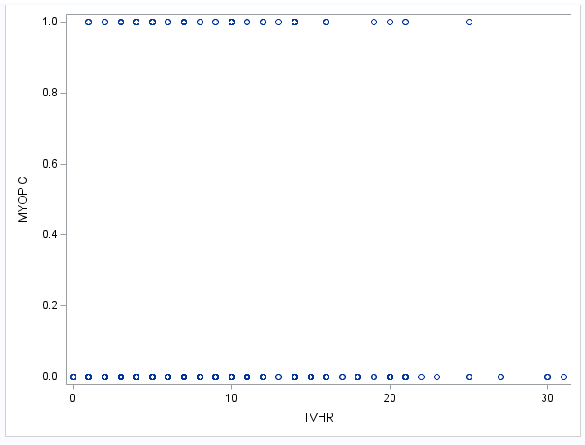

Variable: TVHR
The TVHR variable shows how many hours per week outside of school the child spent watching television

Slide 18
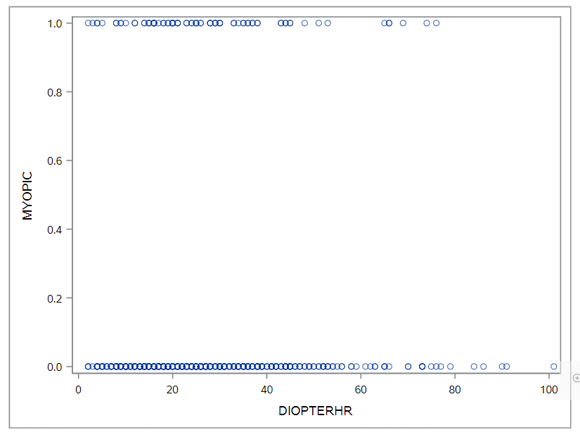
Variable: DIOPTERHR
The DIOPTERHR variable is the composite of near-work activities.
Equation: DIOPTERHR = 3 × (READHR + STUDYHR) + 2 × COMPHR + TVHR.

Slide 19
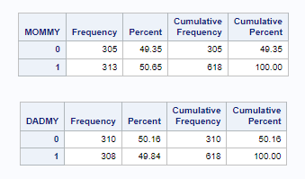
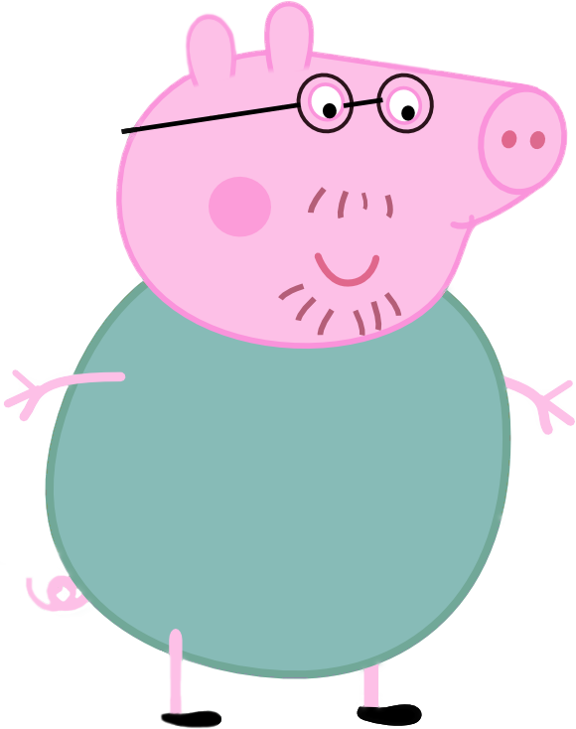
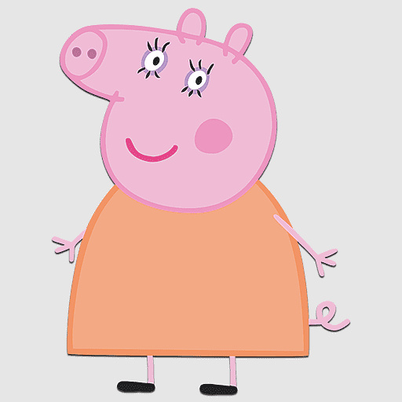
Variables: MOMMY and DADMY
The MOMMY and DADMY variable represent the subject's parents.
The MOMMY variable tells us whether or not the subject's mother was myopic.
The DADMY variable tells us whether or not the subject's father was myopic.
0=No the Mom or Dad was not Myopic
1=Yes the Mom or Dad was Myopic

Slide 20
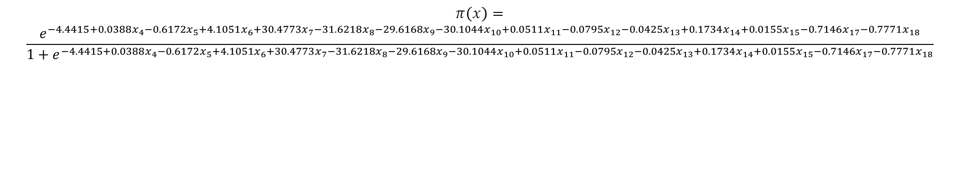
Full Model
$$π\left(x\right)=$$
$$\frac{e^{−4.4415+0.0388x_{4}−0.6172x_{5}+4.1051x_{6}+30.4773x_{7}−31.6218x_{8}−29.6168x_{9}−30.1044x_{10}+0.0511x_{11}−0.0795x_{12}−0.0425x_{13}+0.1734x_{14}+0.0155x_{15}−0.7146x_{17}−0.7771x_{18}}}{1+e^{−4.4415+0.0388x_{4}−0.6172x_{5}+4.1051x_{6}+30.4773x_{7}−31.6218x_{8}−29.6168x_{9}−30.1044x_{10}+0.0511x_{11}−0.0795x_{12}−0.0425x_{13}+0.1734x_{14}+0.0155x_{15}−0.7146x_{17}−0.7771x_{18}}}$$
X value | Parameter Name
x4 | AGE
x5 | GENDER
x6 | SPHEQ
x7 | AL
x8 | ACD
x9 | LT
x10 | VCD
x11 | SPORTHR
x12 | READHR
x13 | COMPHR
x14 | STUDYHR
x15 | TVHR
x17 | MOMMY
x18 | DADMY

Slide 21
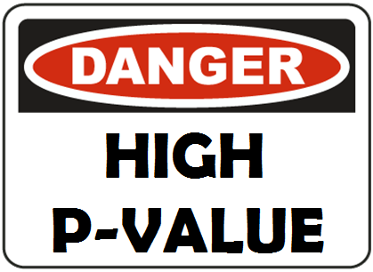
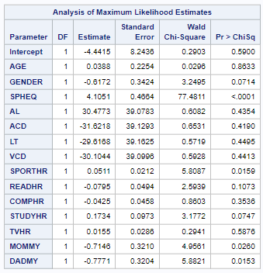
Individual P-Values
The P-values of the variables were checked when the alpha value equaled 0.20. This resulted in the AGE, AL, ACD, LT, VCD, COMPHR and TVHR variables being removed to create Reduced Model 1.

Slide 22

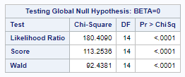
Wald Statistic
Because the p-value is low and the Wald statistic is high, the overall model is significant.

Slide 23
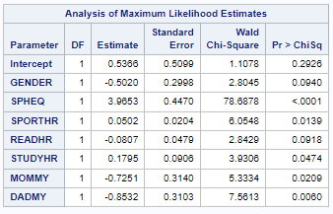
Reduced Model 1
$$π\left(x\right)=$$
$$\frac{e^{0.5366−0.5020GENDER+3.9653SPHEQ+0.0502SPORTHR−0.0807READHR+0.1795STUDYHR−0.7251MOMMY−0.8532DADMY}}{1+e^{0.5366−0.5020GENDER+3.9653SPHEQ+0.0502SPORTHR−0.0807READHR+0.1795STUDYHR−0.7251MOMMY−0.8532DADMY}}$$
The P-values of the variables were checked when the alpha value equaled 0.05. This resulted in the GENDER and READHR variables being removed to create Reduced Model 2.

Slide 24
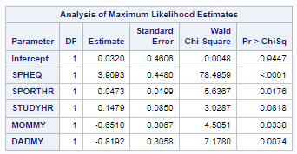
Reduced Model 2
$$π\left(x\right)=$$
$$\frac{e^{0.0320+3.9693SPHEQ+0.0473SPORTHR+0.1479STUDYHR−0.6510MOMMY−0.8192DADMY}}{1+e^{0.0320+3.9693SPHEQ+0.0473SPORTHR+0.1479STUDYHR−0.6510MOMMY−0.8192DADMY}}$$
The P-values of the variables were checked when the alpha value equaled 0.05. This resulted in the STUDYHR variable being removed to create the Final Model.

Slide 25
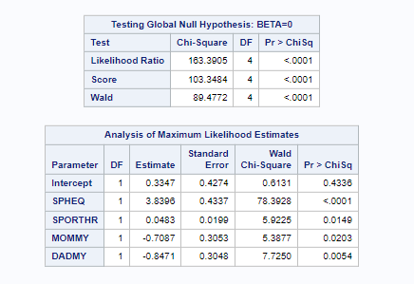
Final Model

Slide 26
Likelihood Ratio Statistic
Because the p-value is low and the likelihood ratio statistic is high, the overall model is significant.

Slide 27
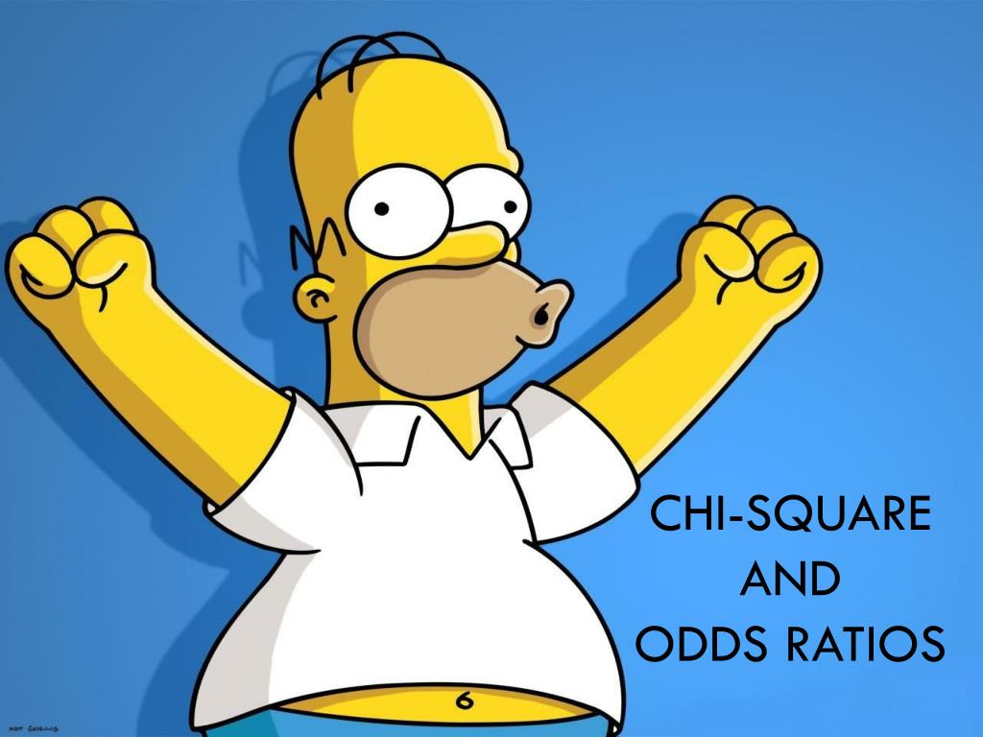
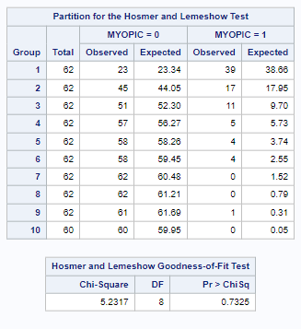
Hosmer Lemeshow Test
The low chi-square value and high p-value indicates that the model fits our data well.

Slide 28
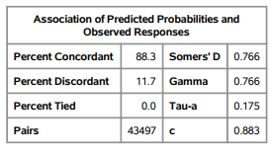
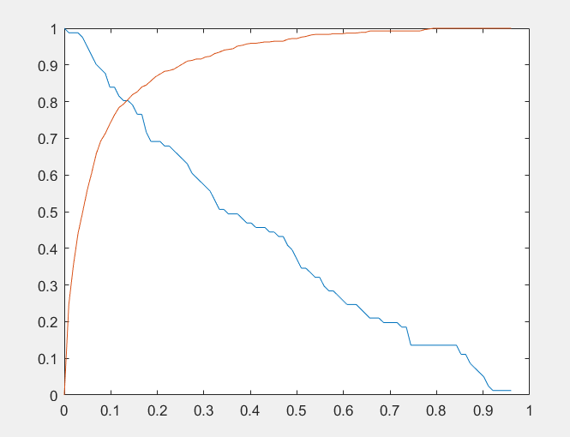
Predicting Probability and Sensitivity specificity plot
A higher percent concordant indicates that our model's prediction are consistent with our outcomes.
The percentage of correct prediction is at 88.3%
The cutoff is at 13%, which gives us the best predicted probability.

Slide 29
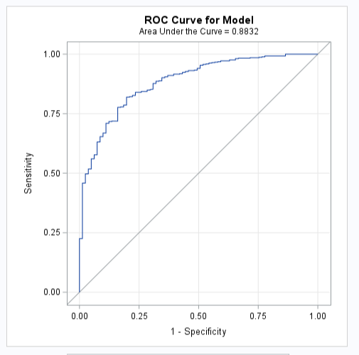
ROC Curve
Our curve suggests excellent discrimination and that the model is good at predicting the correct outcome.

Slide 30
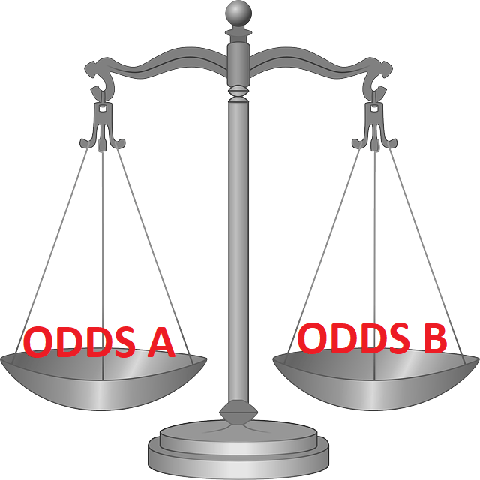
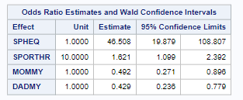
Odds Ratio
For SPHEQ we are comparing the mean of .8 to 1.8
For SPORTHR we are comparing the mean of 11.95 to 21.95
For MOMMY and DADMY we are comparing 0 to 1

Slide 31
Conclusion
The findings highlight the combined influence of genetic predisposition and lifestyle factors on the development of myopia.
These insights pave the way for targeted prevention strategies that could include encouraging outdoor activities and managing near-work activities.
Our study contributes to the broader understanding of myopia and shows the importance of early detection and potential interventions.

Slide 32
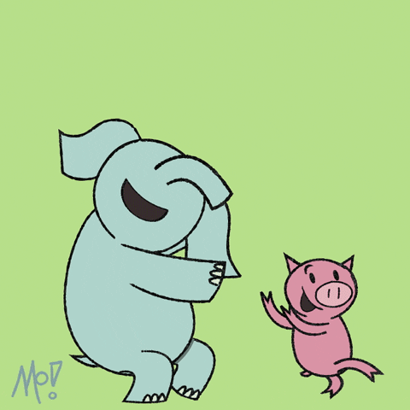
The End?

